Slide 1




APPLY MACHINE LEARNING
TO PREDICT 3D FACIES CUBE

Slide 2
Contents
Machine learning (ML) introduction
ML Workflow and Results QC for Facies classification of MMF30
Result QC for Facies classification at Kim Cuong Area
Conclusions

Slide 3
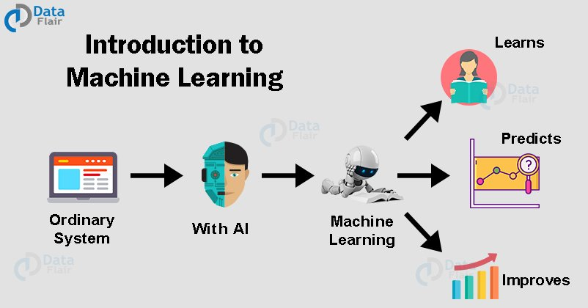
https://data-flair.training/blogs/machine-learning-tutorial/
What Is Machine Learning?
Machine Learning is popular technique of predicting the future or classifying information to help people in making necessary decisions
Machine Learning algorithms are trained over instances or examples through which they learn from past experience and also analyze the historical data
Notes:
Machine Learning cơ bản là một mô hình có khả năng “học tập” một lượng lớn dữ liệu, đọc được những khuôn mẫu (pattern) trong dữ liệu và thực hiện một nhiệm vụ nào đó, có thể là đưa ra những phân loại, dự đoán. Có thể hiểu đơn giản là giống như cách con người học, “máy học” cũng là quá trình huấn luyện máy tính dựa trên những dữ liệu, khuôn mẫu đã có nhằm hoàn thành một công việc trong tương lai một cách tốt hơn mà con người không cần thủ công can thiệp.

Slide 4
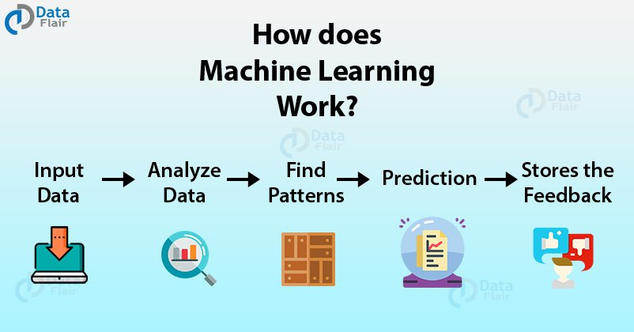
How Machine Learning Work?
https://data-flair.training/blogs/machine-learning-tutorial/

Slide 5
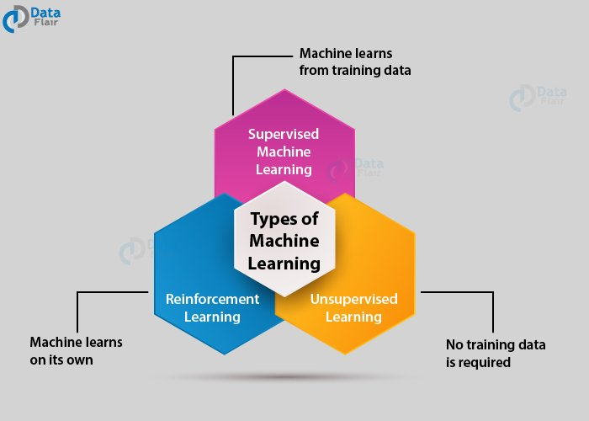
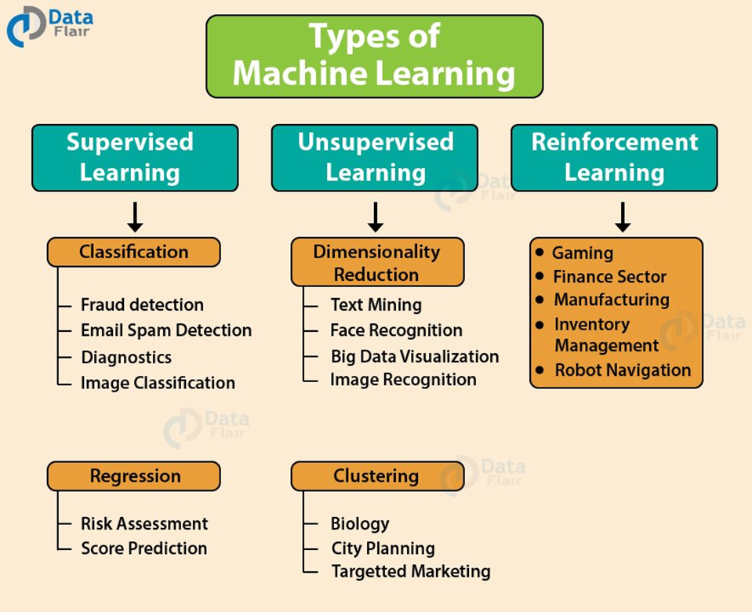
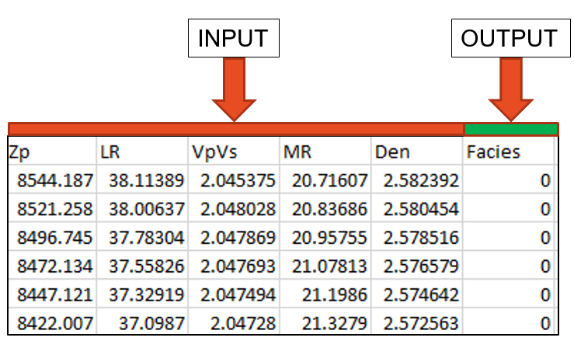
Type of Machine Learning
Supervised learning : train dataset is labeled (input +output)
Unsupervised Learning: deals with the unlabeled data
https://data-flair.training/blogs/machine-learning-tutorial/

Slide 6
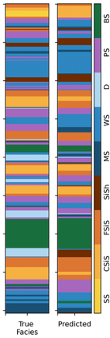
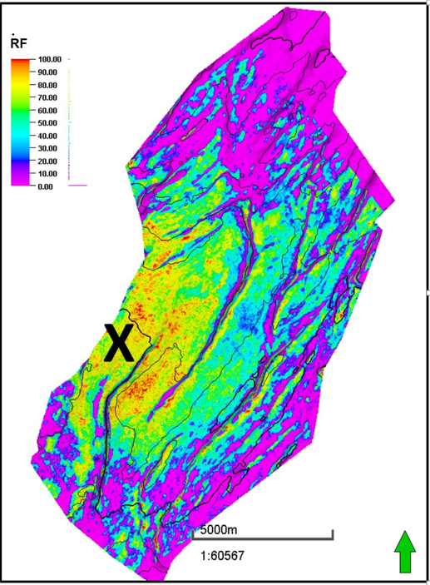
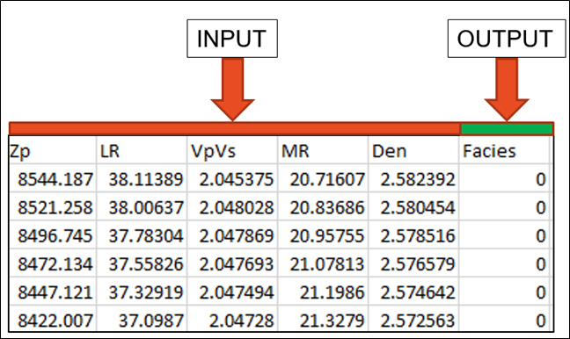
CAN MACHINE LEARNING WORK FOR FACIES CLASSIFICATION?
Predicting facies is classification proved working well by Machine learning
Data available: including 4 wells of MMF30 labeled for trained model and seismic data at predicted area
Available
2D
Data at well location
Data at remote area
Need
3D
???

Slide 7
MMF30 FACIES PREDICTION

Slide 8
Introduction
Study objective:
Use supervised machine learning to predict litho-facies cube (sand-shale) of MMF30 and
Data used:
Lamda Rho, Acoustic impedance, Density, M-Rho, Vp-Vs
4 wells data of MMF30 (HT-2X, HT-3P, HT-8P and HT-9P)
KCT-1X for Sand10 prediction
ML algorithms:
Supervised classification algorithm such as: Decision tree, LDA, random forest, K-means…
Cross validation
Coded by Python 3.8.4

Slide 9
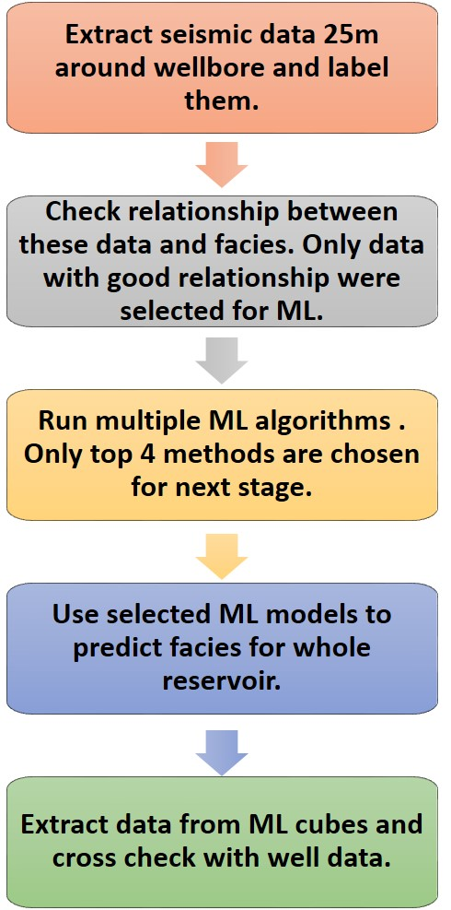
WORKFLOW

Slide 10
Data preparation

Slide 11
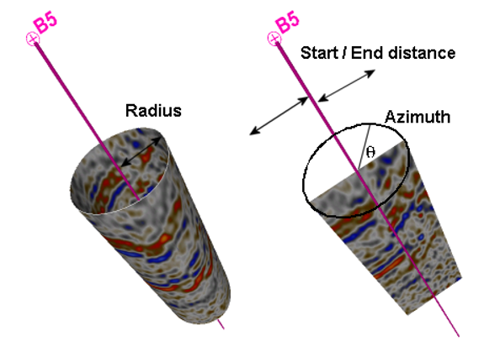
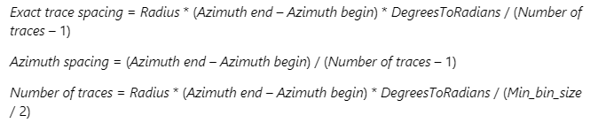
Seismic data extraction
Seismic data extraction:
Orbital extraction
Radial extraction
For this study:
Orbital extraction
Radius 25 and 50m
(seismic grid size: 25m)
Seismic cubes:
LambdaRho
MuRho
VpVs
Zp
Density
Orbital extraction
Radial extraction
Number of traces / spacing
Manual set

Slide 12
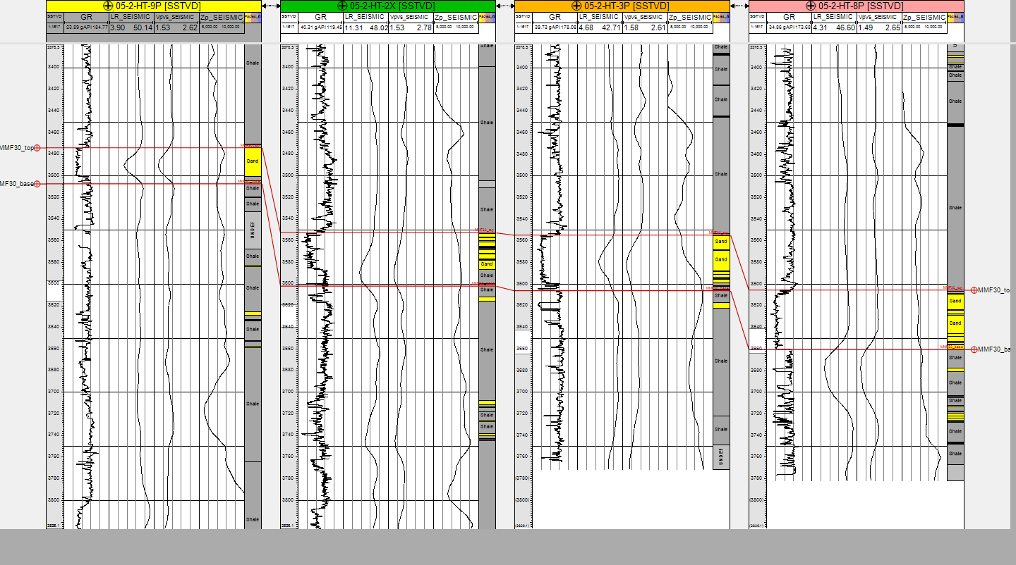
Time-Depth Relationship Check
LR
VpVs
Zp
LR
VpVs
Zp
LR
VpVs
Zp
LR
VpVs
Zp
T-D Relationship issues
T-D Relationship issues

Slide 13
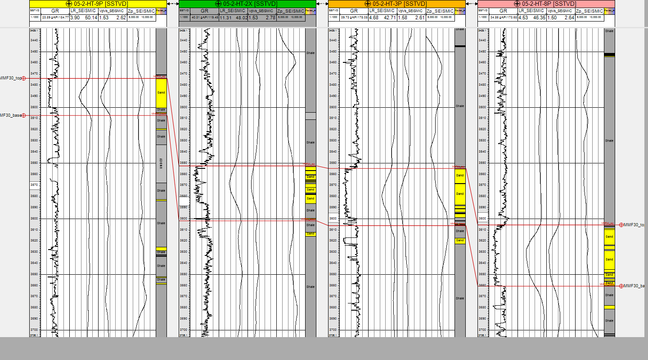
Time-Depth Relationship Fix
LR
VpVs
Zp
LR
VpVs
Zp
LR
VpVs
Zp
LR
VpVs
Zp
T-D Relationship issues
T-D Relationship Fixed

Slide 14
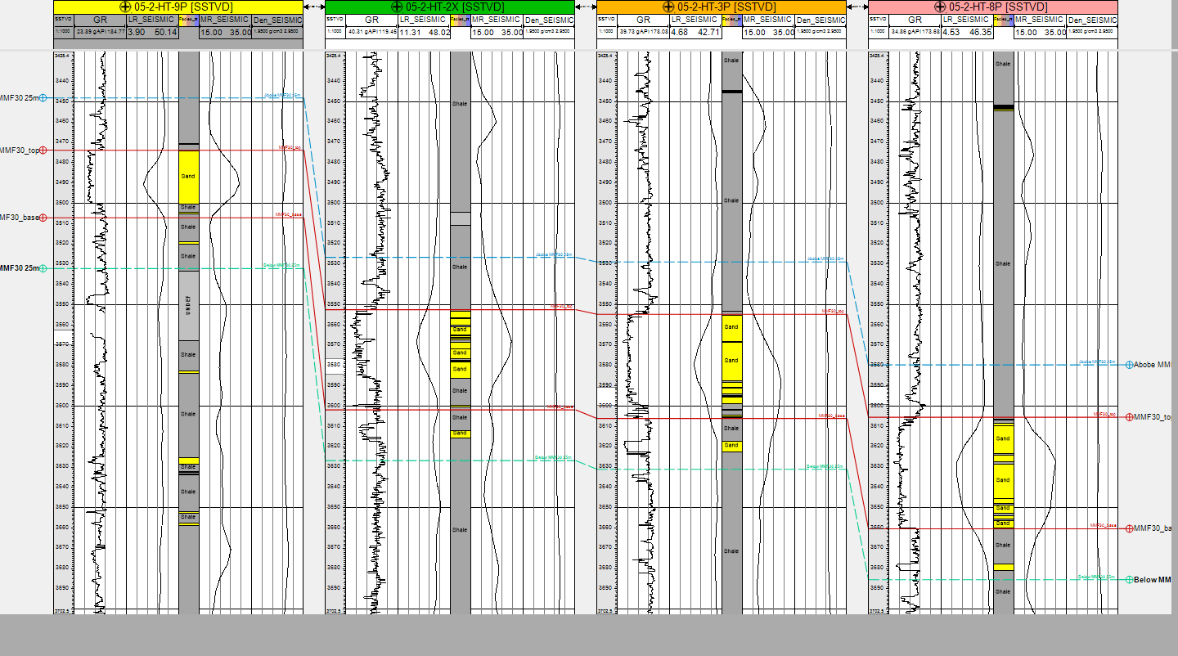
LDR-MR-Den Seismic-log
LR
MR
Den
LR
MR
Den
LR
MR
Den
LR
MR
Den
Density seismic is not informative for Lithology changing!

Slide 15
INPUT Data STATISTIC and Visualization

Slide 16
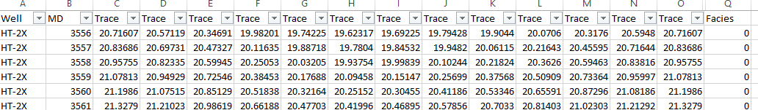
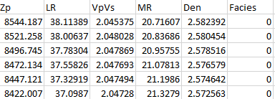
Data input statistic
Raw data
Processed data
Data Statistic_R25
Total samples: 5515
Sand: Shale (3:4)

Slide 17
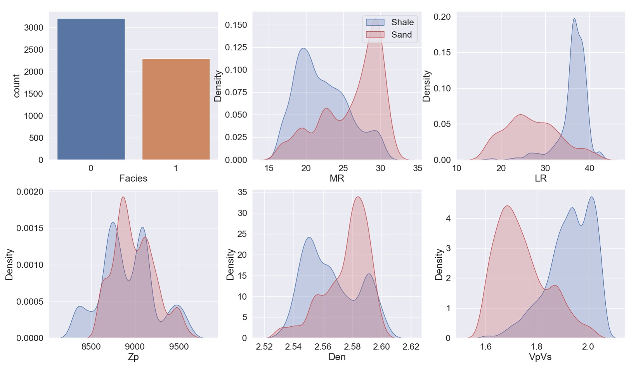
Mmf30 Elastic properties by facies
Zp: not qualified for facies indicatiom
Den, LR,VpVs and MR: quite good for facies indication

Slide 18
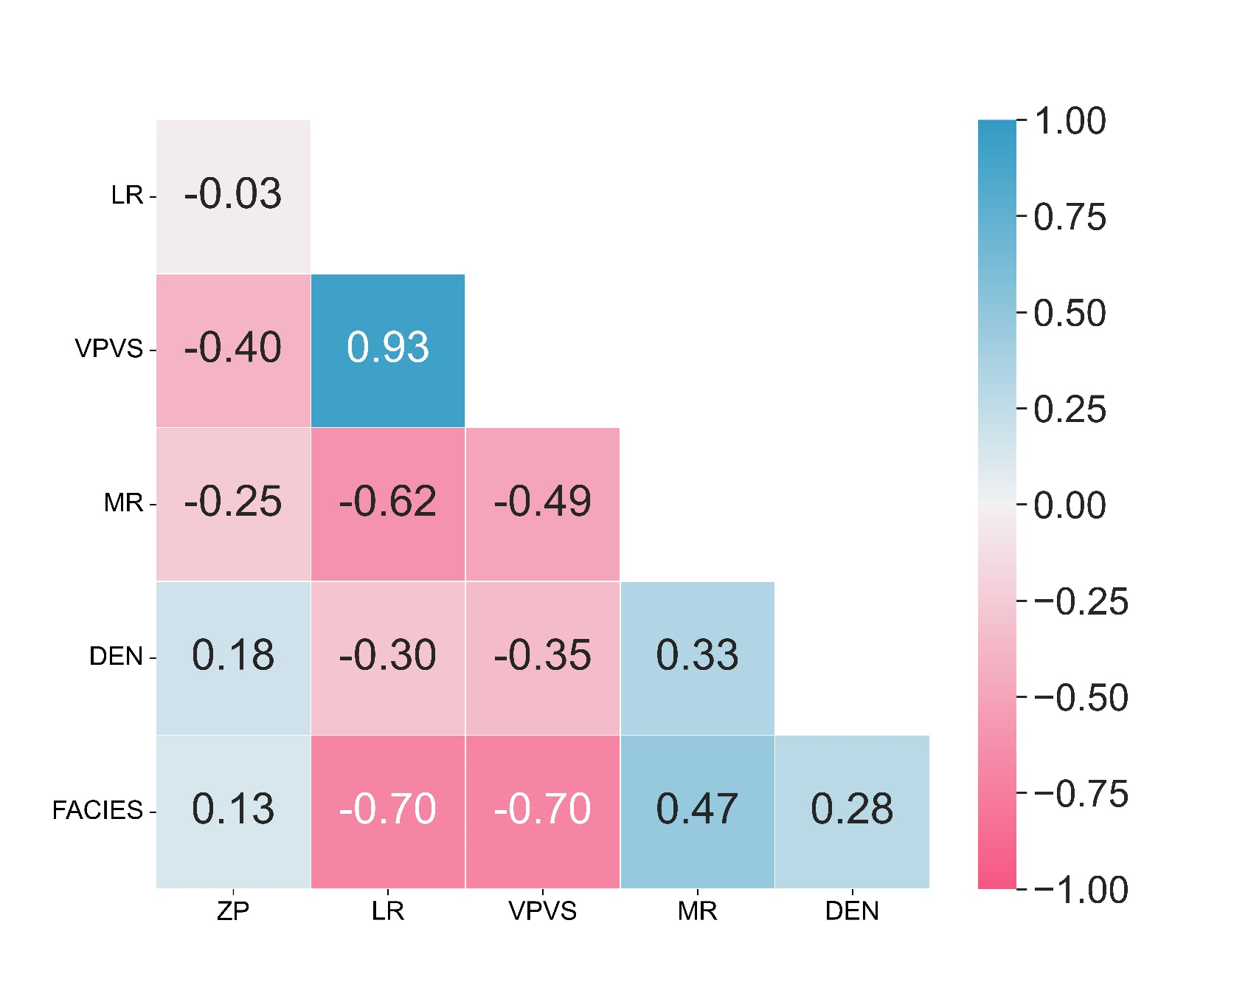
Elastic PROPERTIES AND FACIES correlation
This map shows correlation coefficient between elastic properties and facies
Zp and Den: positive correlation but quite low
LR, VpVs: High negative correlation
MR: medium positive correlation
Notes:
LR and VpVs attribute is strongest one to separate facies

Slide 19
ML WORKFLOW AND QC RESULTS BY ML SCORES

Slide 20
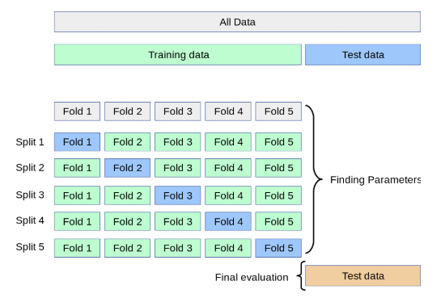
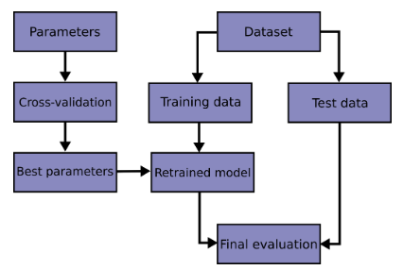
MACHINE LEARNING WORKFLOW
https://scikit-learn.org/stable/modules/cross_validation.html
https://www.miai.vn/2021/01/18/k-fold-cross-validation-tuyet-chieu-train-khi-it-du-lieu/

Slide 21
Machine Learning Score Results
AI Algorithm | Training Score | Test Score
K-Nearest Neighbors(*) | 0.94 | 0.92
Decision Tree Classifier(*) | 1.00 | 0.90
Support Vector Machine(*) | 0.90 | 0.90
Random Forest(*) | 0.88 | 0.87
Logistic Regression Classifier | 0.87 | 0.86
Bernoulli Classifier | 0.87 | 0.86
Linear Discriminant Analysis | 0.87 | 0.86
Gaussian Naïve Bayes | 0.86 | 0.86
Notes:
https://www.noron.vn/post/tim-hieu-ve-confusion-matrix-trong-machine-learning-5279053053043113

Slide 22
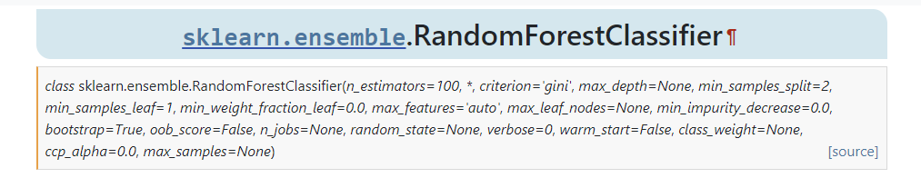
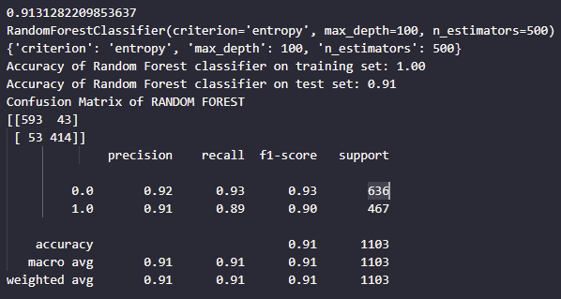
Optimize hyper-parameters of RDF
https://scikit-learn.org/stable/modules/generated/sklearn.ensemble.RandomForestClassifier.html

Slide 23
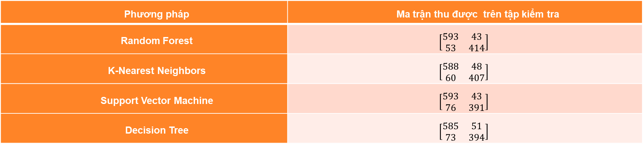
Machine Learning Score Results
Phương pháp | Điểm số trung bình
Random Forest | 0.907
Support Vector Machine | 0.896
K-Nearest Neighbors | 0.895
Decision Tree | 0.892
Phương pháp | Ma trận thu được trên tập kiểm tra
Random Forest | $$\left[\begin{matrix}593 & 43 \\ 53 & 414\end{matrix}\right]$$
K-Nearest Neighbors | $$\left[\begin{matrix}588 & 48 \\ 60 & 407\end{matrix}\right]$$
Support Vector Machine | $$\left[\begin{matrix}593 & 43 \\ 76 & 391\end{matrix}\right]$$
Decision Tree | $$\left[\begin{matrix}585 & 51 \\ 73 & 394\end{matrix}\right]$$

Slide 24
QC RESULTS BY MAPS

Slide 25
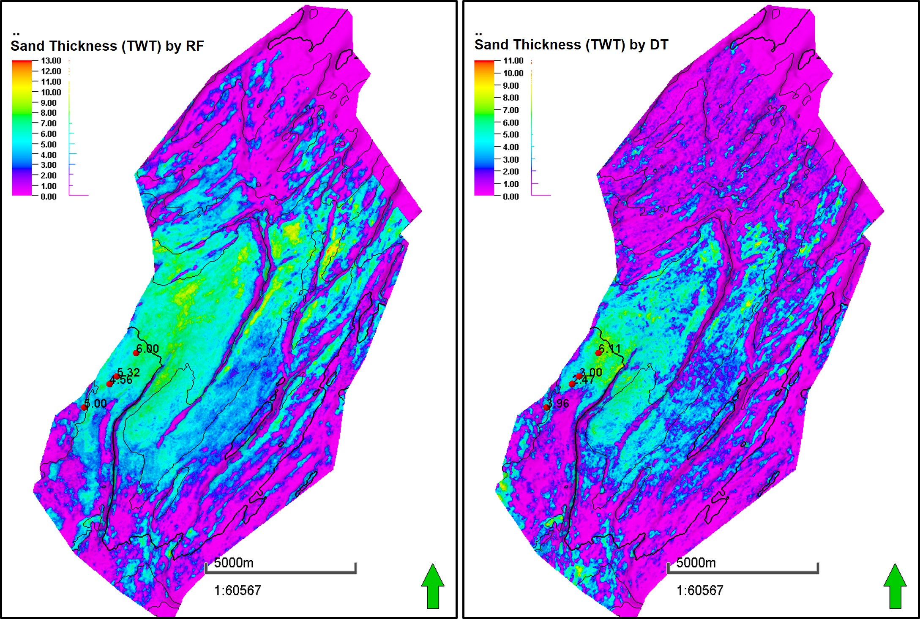
MMF30 SAND THICKNESS MAP BY ML

Slide 26
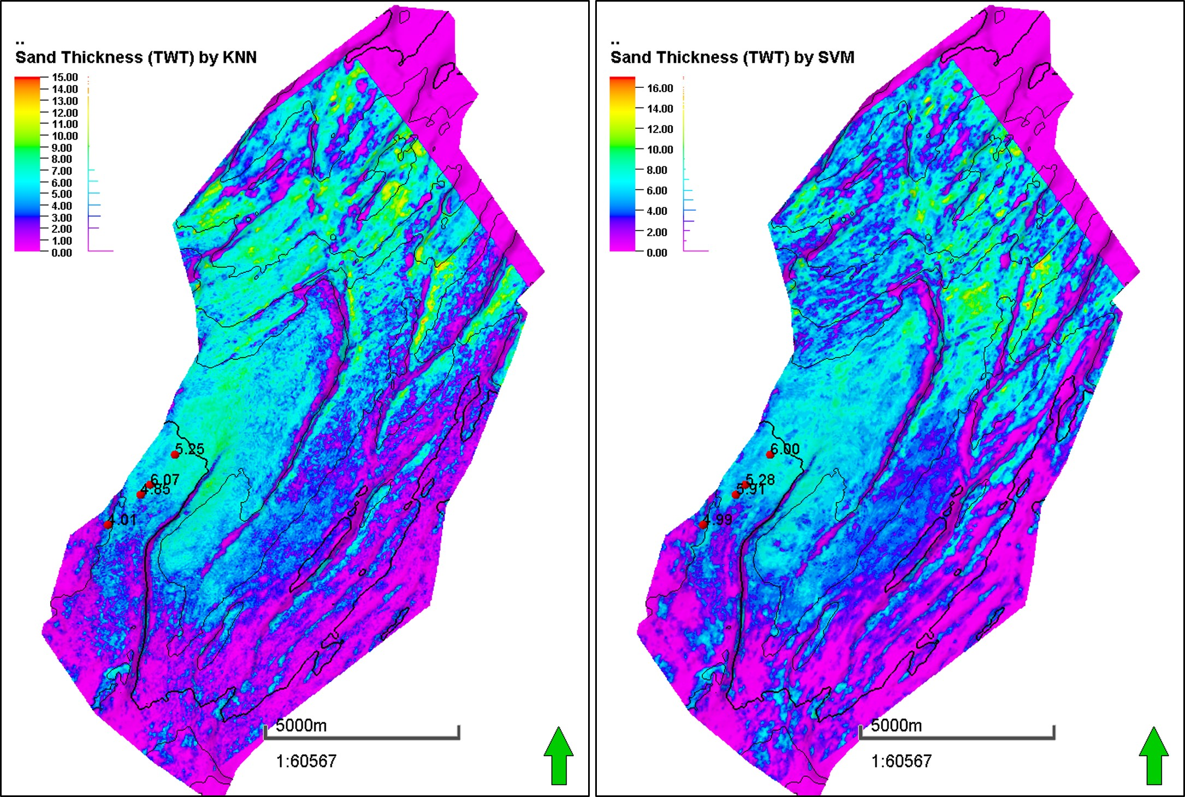
MMF30 SAND THICKNESS MAP BY ML

Slide 27
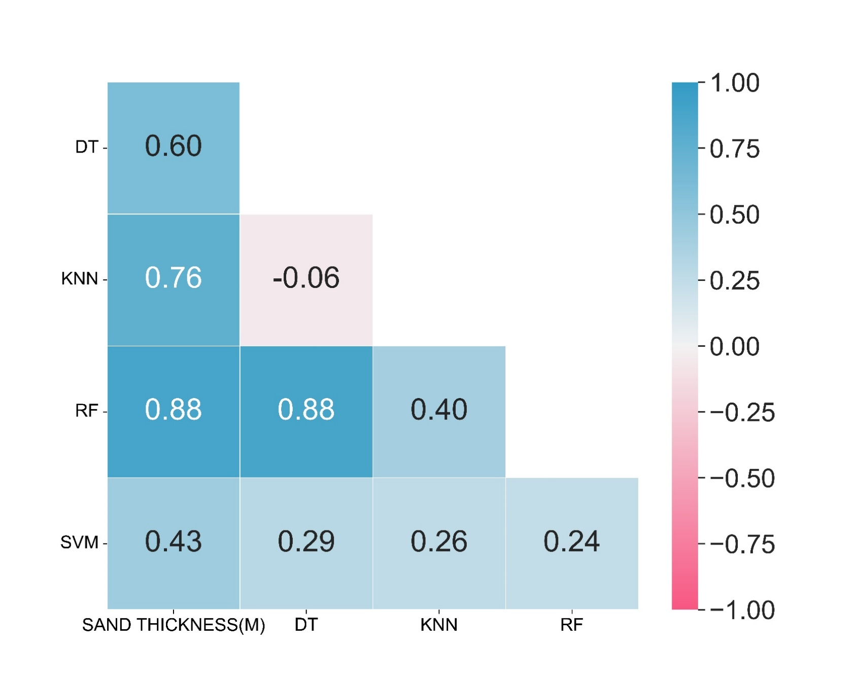
HEAT MAP BETWEEN SAND THICKNESS AND WELL DATA
Random Forest: Highest correlation with sand thickness at well (0.88)
SVM: Lowest correlation (0.43)

Slide 28
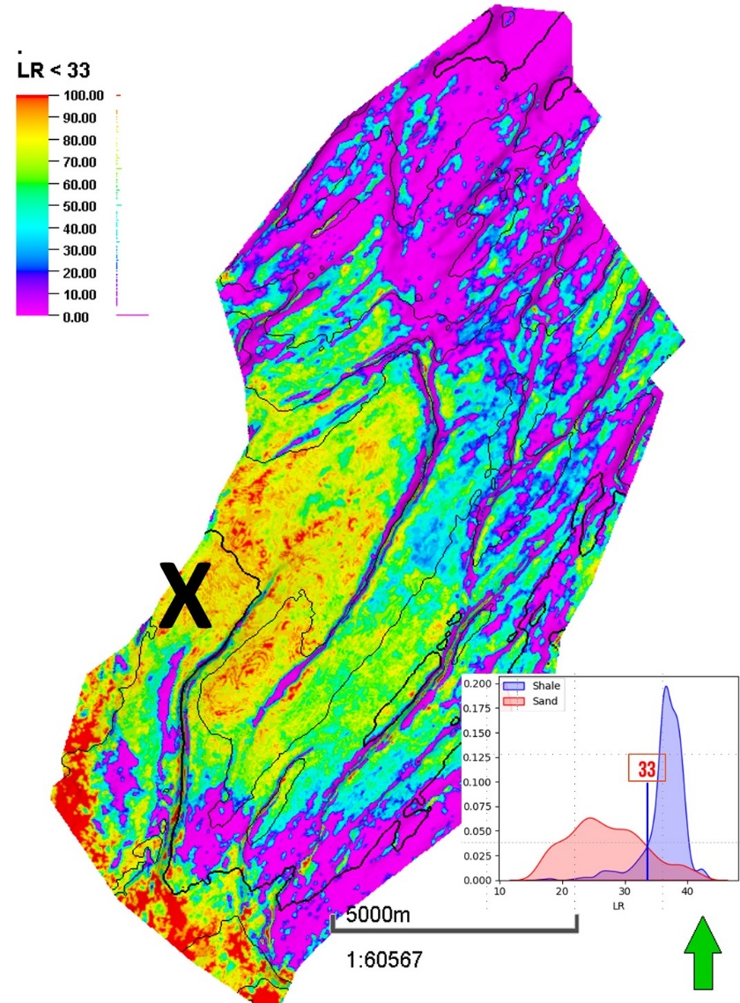
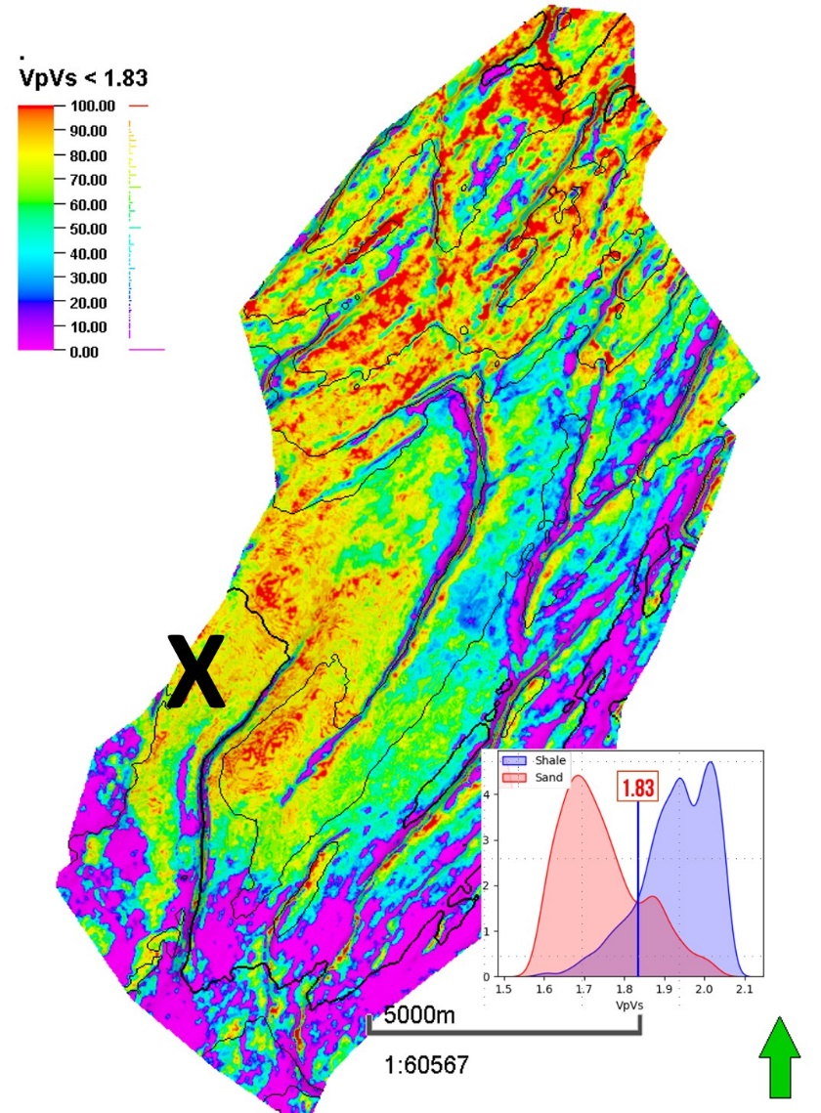
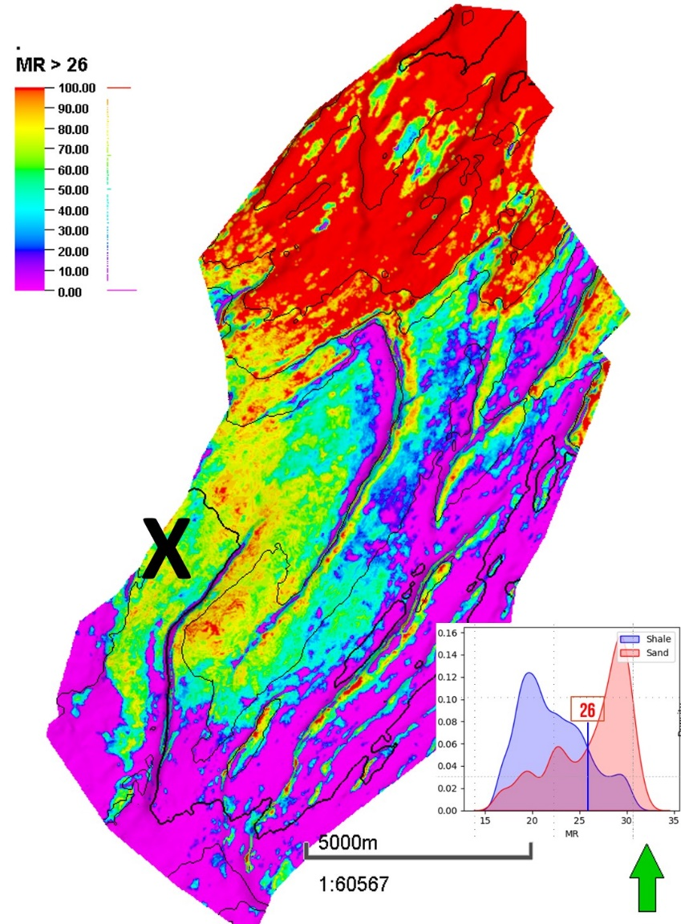
MMF30 Attribute Maps
Notes:
thuộc tính Lambda-Rho với nhỏ hơn giá trị ngưỡng (xác định bằng đồ thị đường cong mật độ lambda-rho) (Hình 9) cho thấy kết quả hợp lý ở khu vực đã khoan (khu vực X), nhưng rất nhiều khu vực xa xung quanh, có rất nhiều dị thường và phân bố có vẻ phi địa chất, đặc biệt là ở khu vực phía nam. VpVs và Mu-Rho cũng cho kết quả tương tự (Hình 10, Hình 11). Do đó, việc lựa chọn một thuộc tính tốt nhất để sử dụng trong trường hợp này là rất khó khăn và rủi ro. Do đó, để giảm rủi ro minh giải, phương pháp biểu đồ chéo (crossplot) hai thuộc tính Lambda-Rho và Mu-Rho được sử dụng (Hình 12 bên trái).

Slide 29
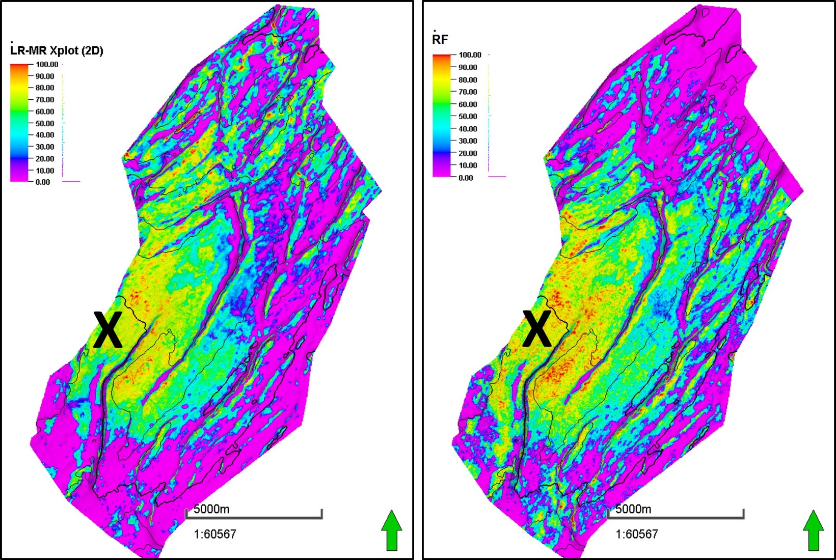
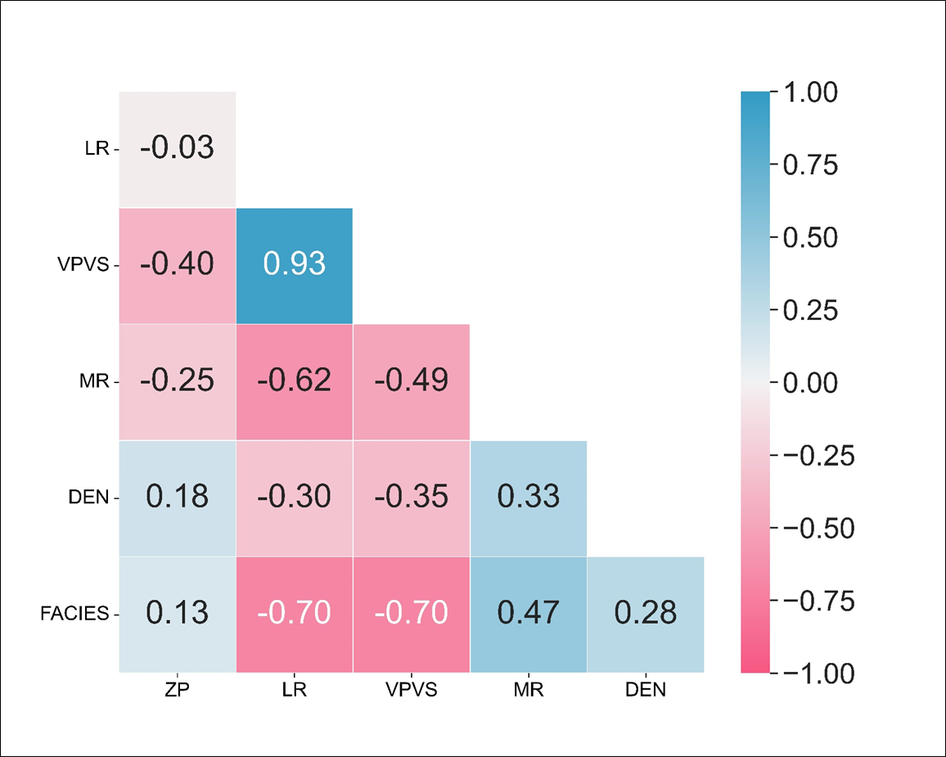
2D XPLOT VS ML MAP
2D cross-plot:
Cross-plot between LR and MR
Threshold input parameter is sensitive and highly depend on experience of interpreters
Some valuable features from others attribute can be neglected (VpVs)
ML:
All input data are utilized
Result are objective, reasonable and promising
Time saving for batch data

Slide 30
KC Area Results

Slide 31
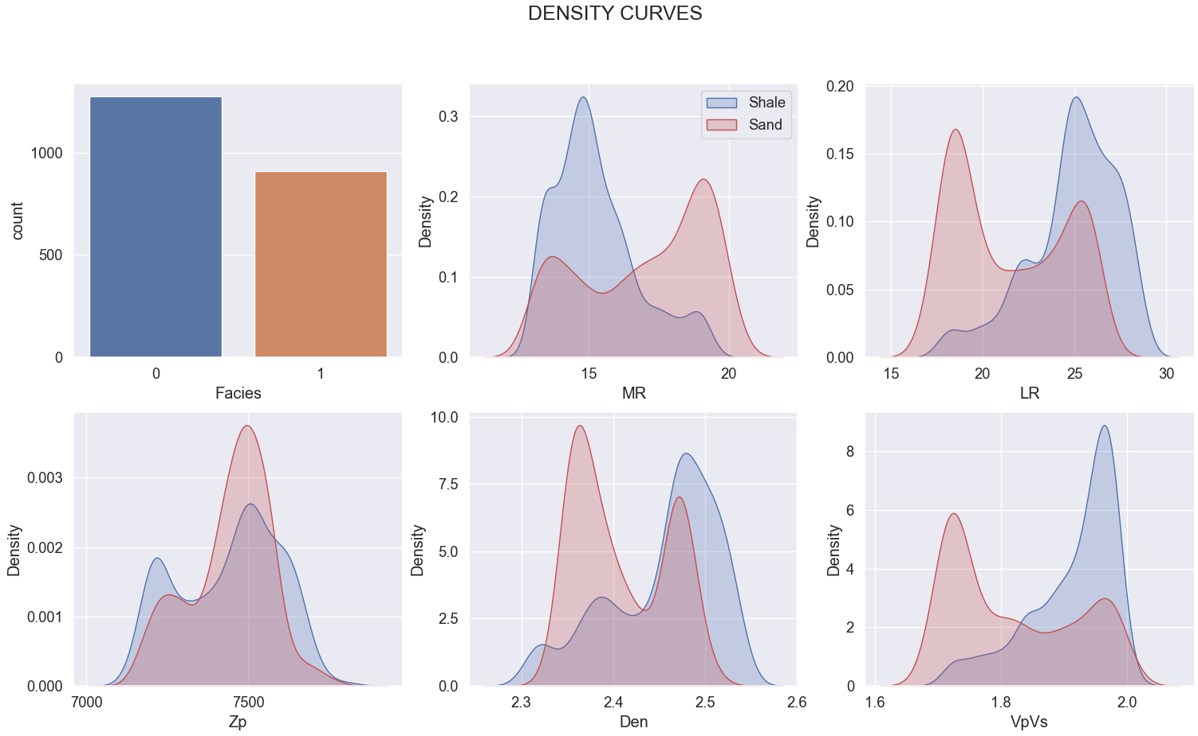
Sand10 Elastic Properties By Facies

Slide 32
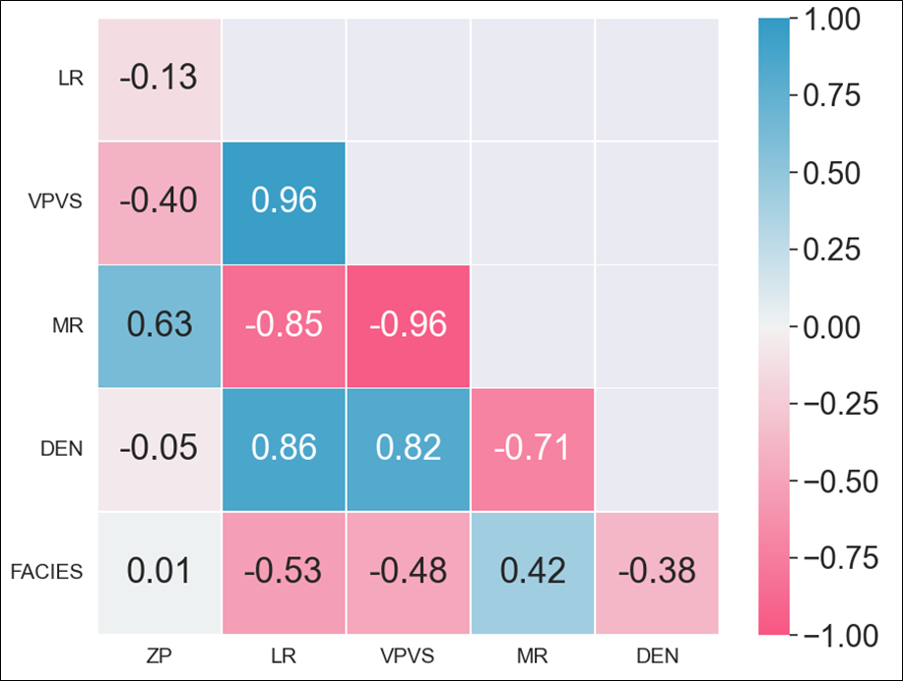
ELASTIC PROPERTIES AND FACIES CORRELATION
This map shows correlation coefficient between elastic properties and facies
Zp: Lowest positive correlation
LR, VpVs, MR, Den: Moderate correlation

Slide 33
QC RESULTS BY ML SCORES

Slide 34
Machine Learning Score Results
Phương pháp | Điểm số trung bình
Support Vector Machine | 0.813
Random Forest | 0.795
KNN | 0.795
LightGBM | 0.792
XGBoost | 0.781
Decision Tree | 0.774
Gaussian Naïve Bayes | 0.739

Slide 35
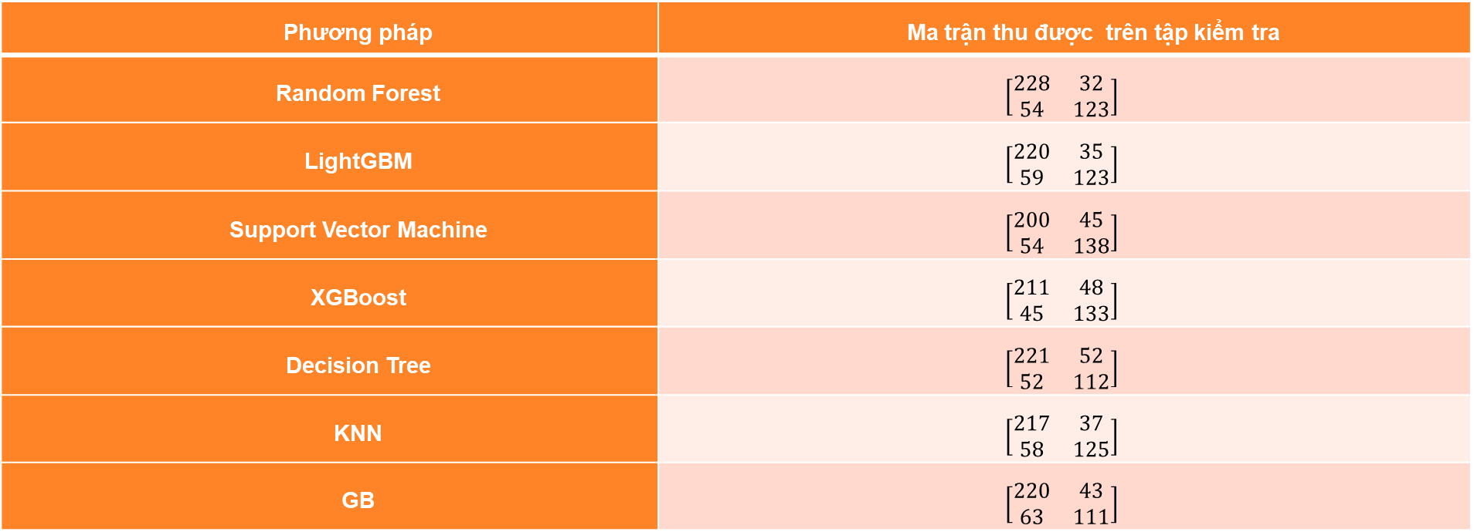
Machine Learning Score Results
Phương pháp | Ma trận thu được trên tập kiểm tra
Random Forest | $$\left[\begin{matrix}228 & 32 \\ 54 & 123\end{matrix}\right]$$
LightGBM | $$\left[\begin{matrix}220 & 35 \\ 59 & 123\end{matrix}\right]$$
Support Vector Machine | $$\left[\begin{matrix}200 & 45 \\ 54 & 138\end{matrix}\right]$$
XGBoost | $$\left[\begin{matrix}211 & 48 \\ 45 & 133\end{matrix}\right]$$
Decision Tree | $$\left[\begin{matrix}221 & 52 \\ 52 & 112\end{matrix}\right]$$
KNN | $$\left[\begin{matrix}217 & 37 \\ 58 & 125\end{matrix}\right]$$
GB | $$\left[\begin{matrix}220 & 43 \\ 63 & 111\end{matrix}\right]$$

Slide 36
QC RESULTS BY ML Maps

Slide 37
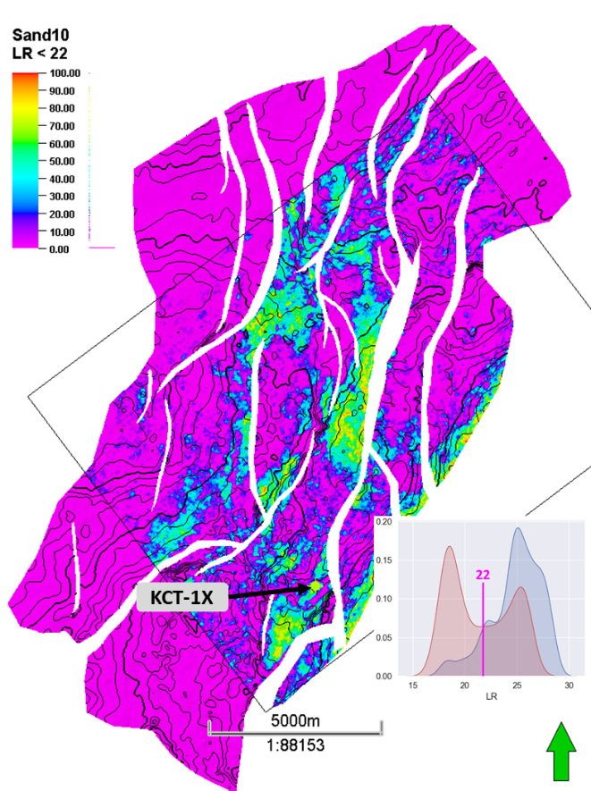
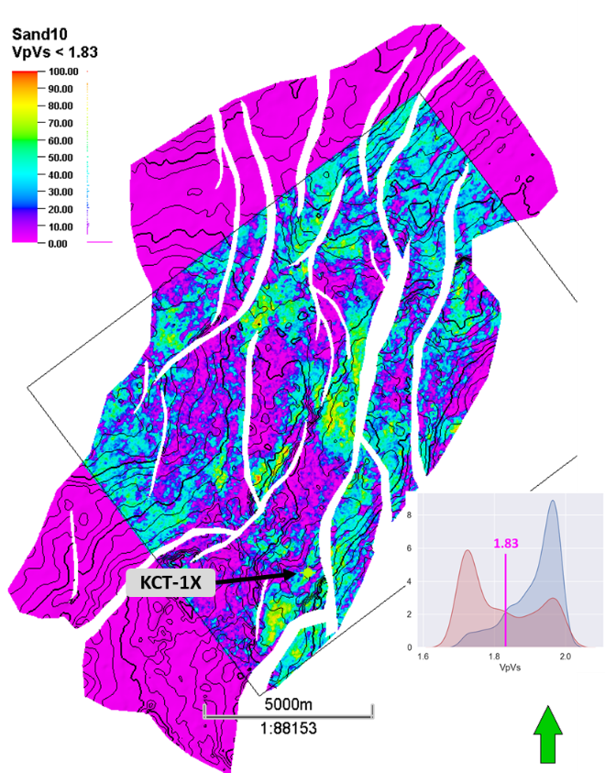
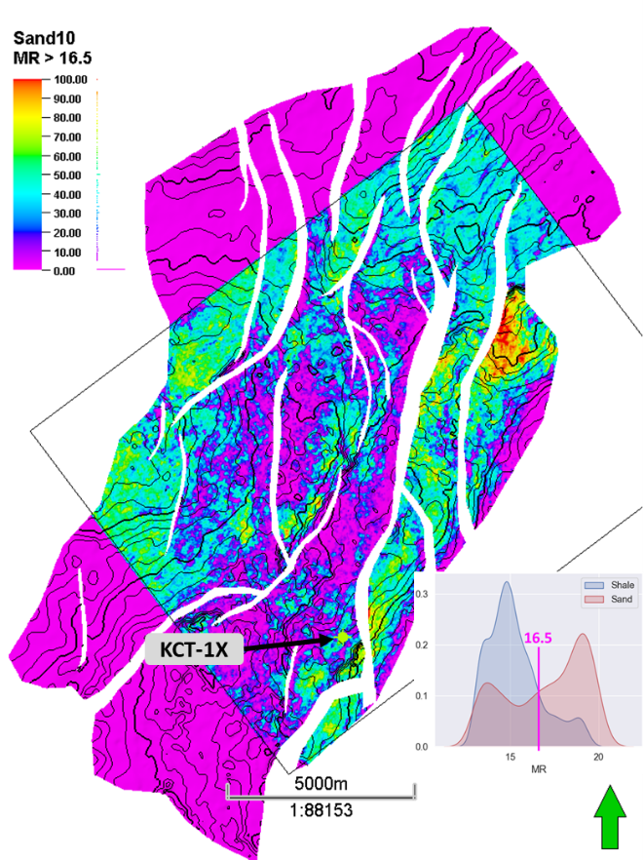
Sand10 Attribute Maps
Results is good at well location
Results not consistent over attribute
Much noise/ anomalies at surrounding area causes confusing.

Slide 38
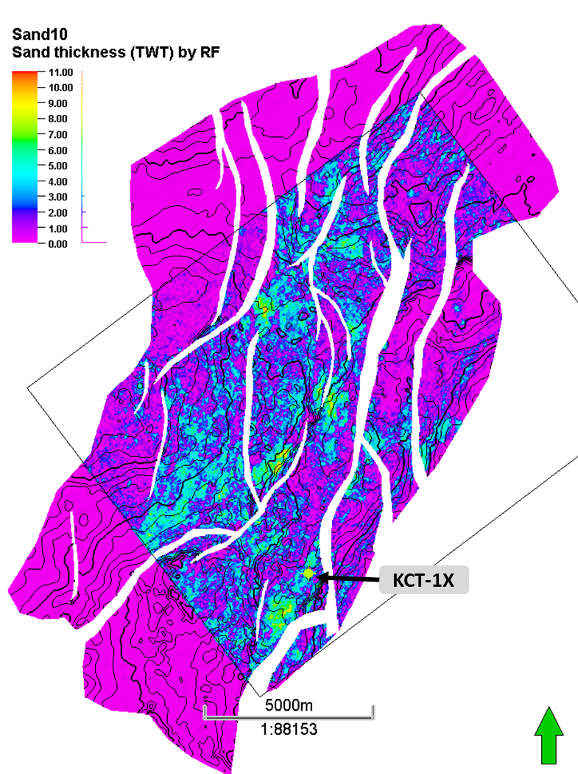
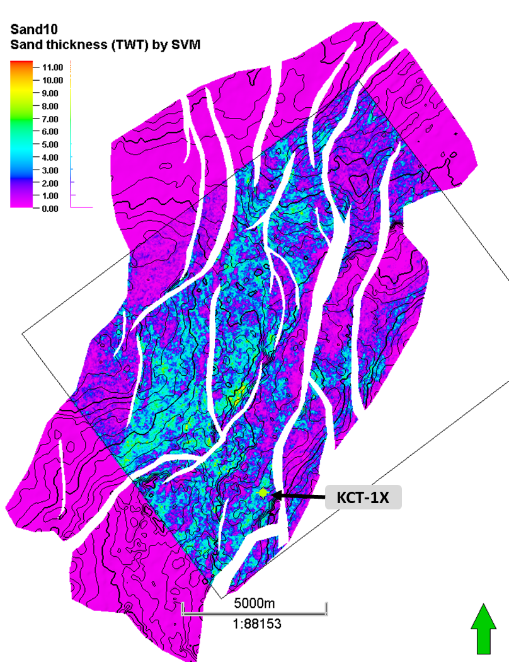
ML Maps

Slide 39
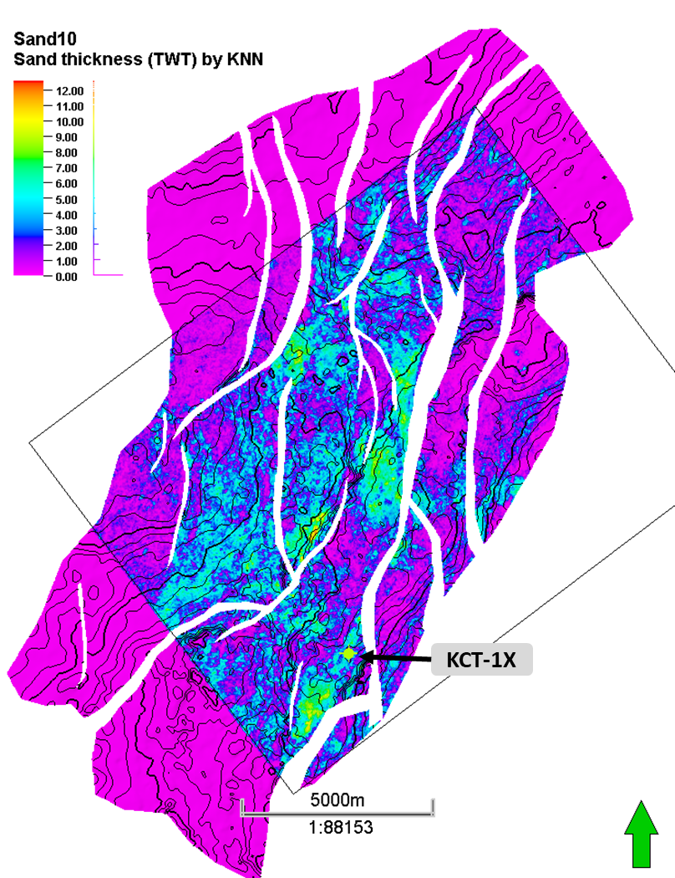
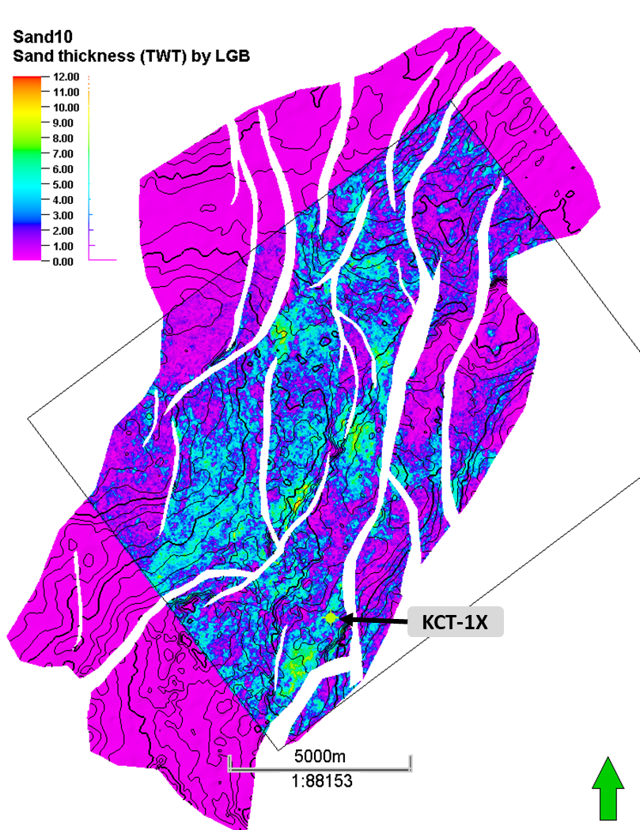
ML Maps

Slide 40
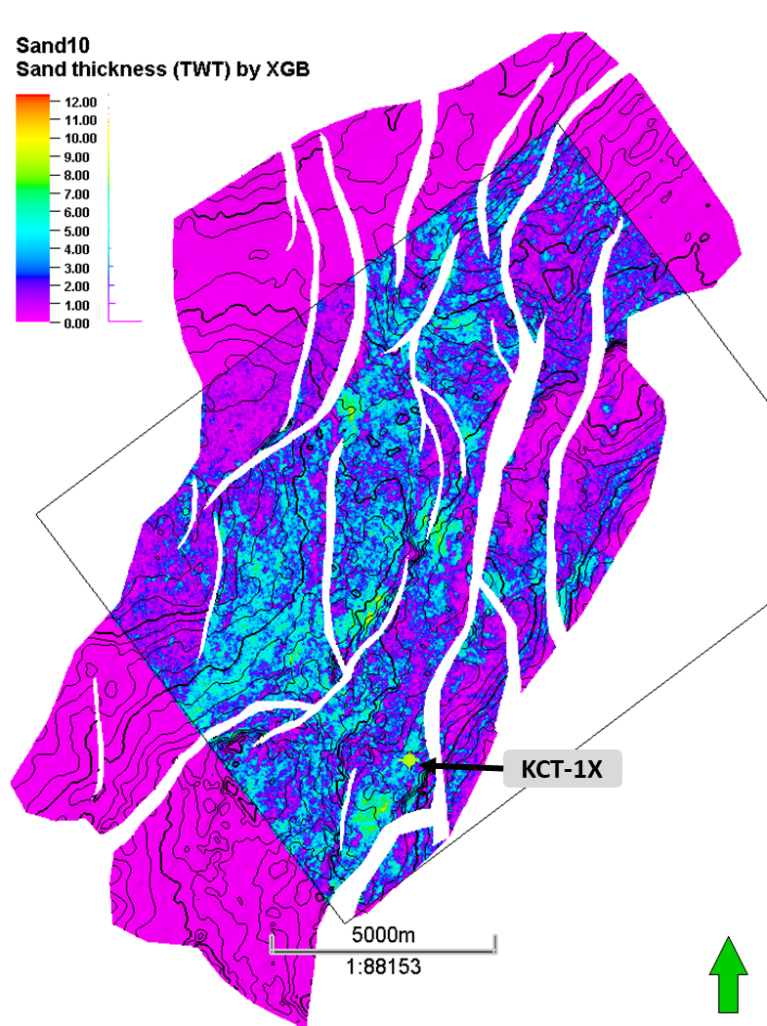
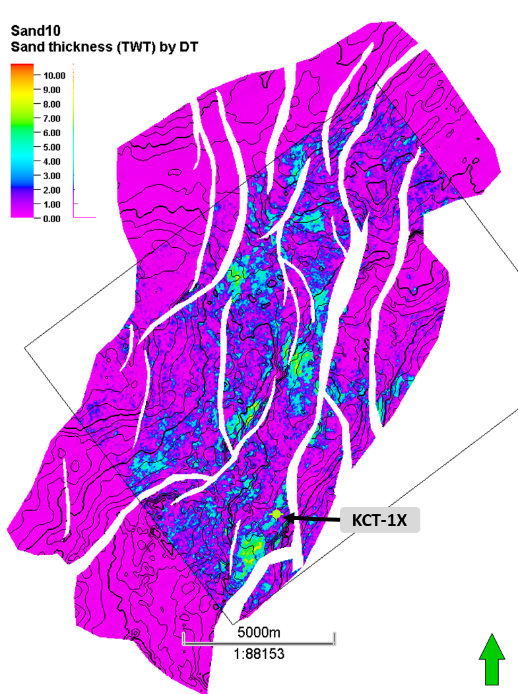
ML Maps
Results is good at well location
Consistent result over algorithms.
Not confusing by noise

Slide 41
Conclusions
ML results is extremely objective. All valuable data are utilized through learning.
ML maps show high quality and geological meanings for both MMF30 and Sand10
Set of ML maps for Sand10 can help geologist limit uncertainty for sand boundary polygon from min to max case.
Consistent and high quality of ML maps can help geologist to minimize risk when set position for in-fill wells

Slide 42
Thank you!

Slide 43
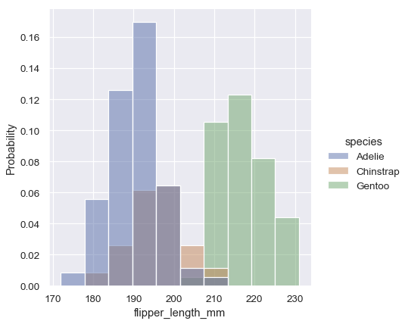
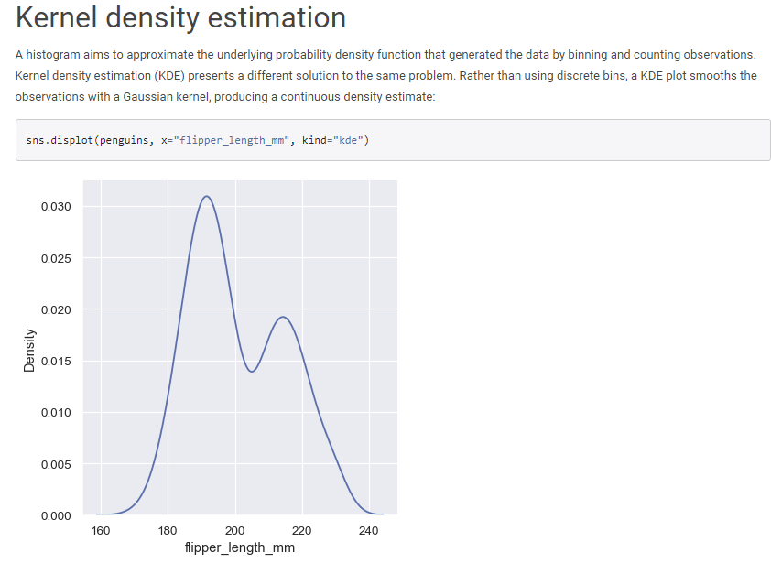
Density Curve
https://seaborn.pydata.org/tutorial/distributions.html

Slide 44
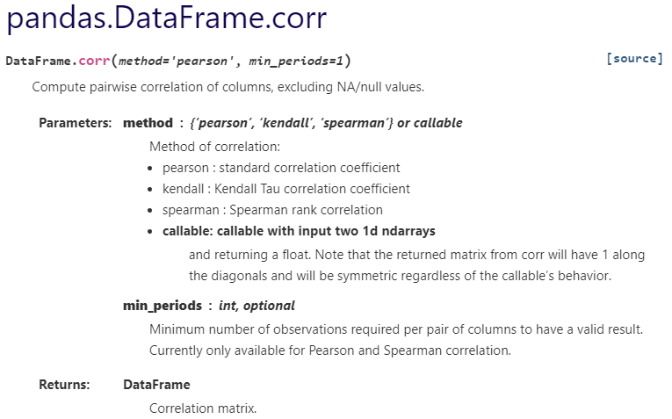
Pandas correlation matrix

Slide 45
ML in Oil and Gas Industry
Facies predicting (2D and 3D)
LGR selection for history matching
WHP pressure regression (DCA)

